Slide 1
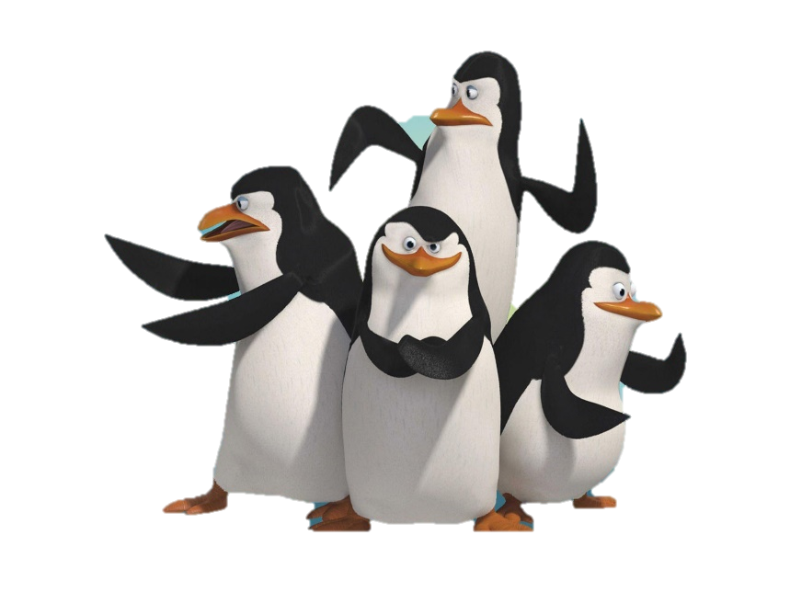
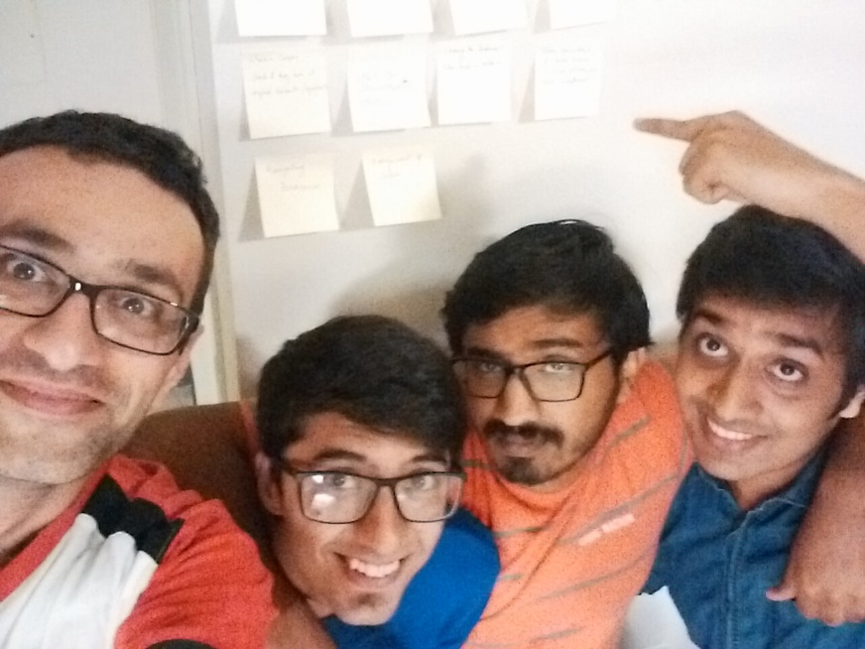
Software Development Class - IST 303 Midterm Presentation Professor Terry Ryan Gila Breath Camp
Team #Penguins:
Jemin Gohil (aka Rico)
Karthik Manjunath (aka Kowalski)
Rohan Sawant (aka Skipper)
Soheil Bouzari (aka Private)

Slide 2


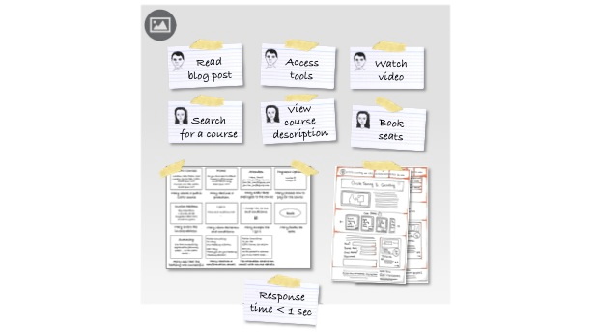
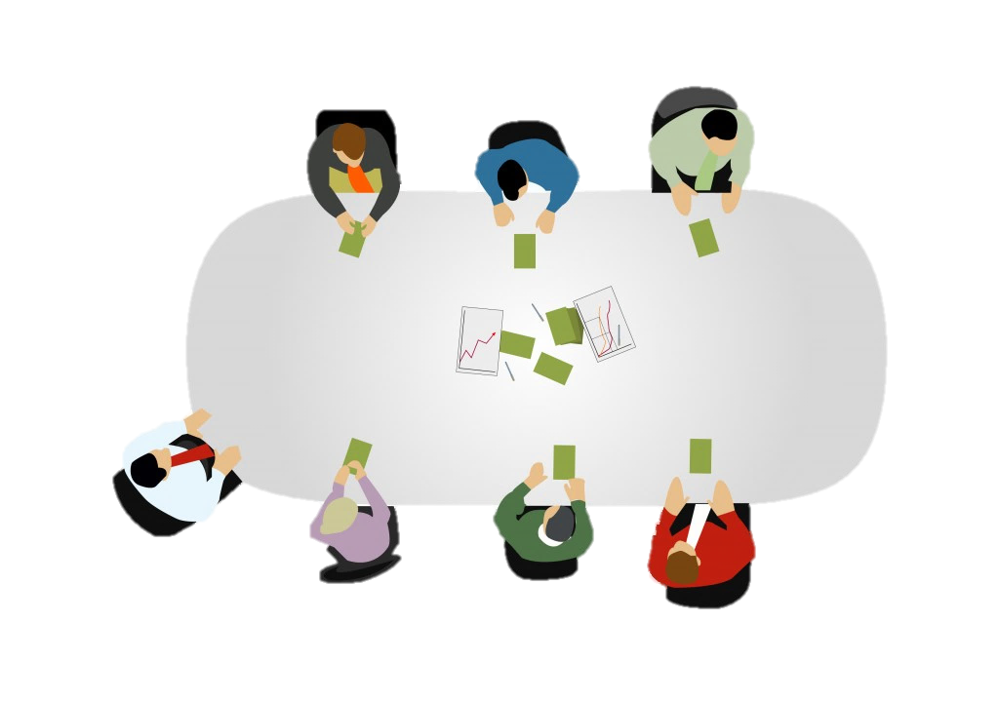

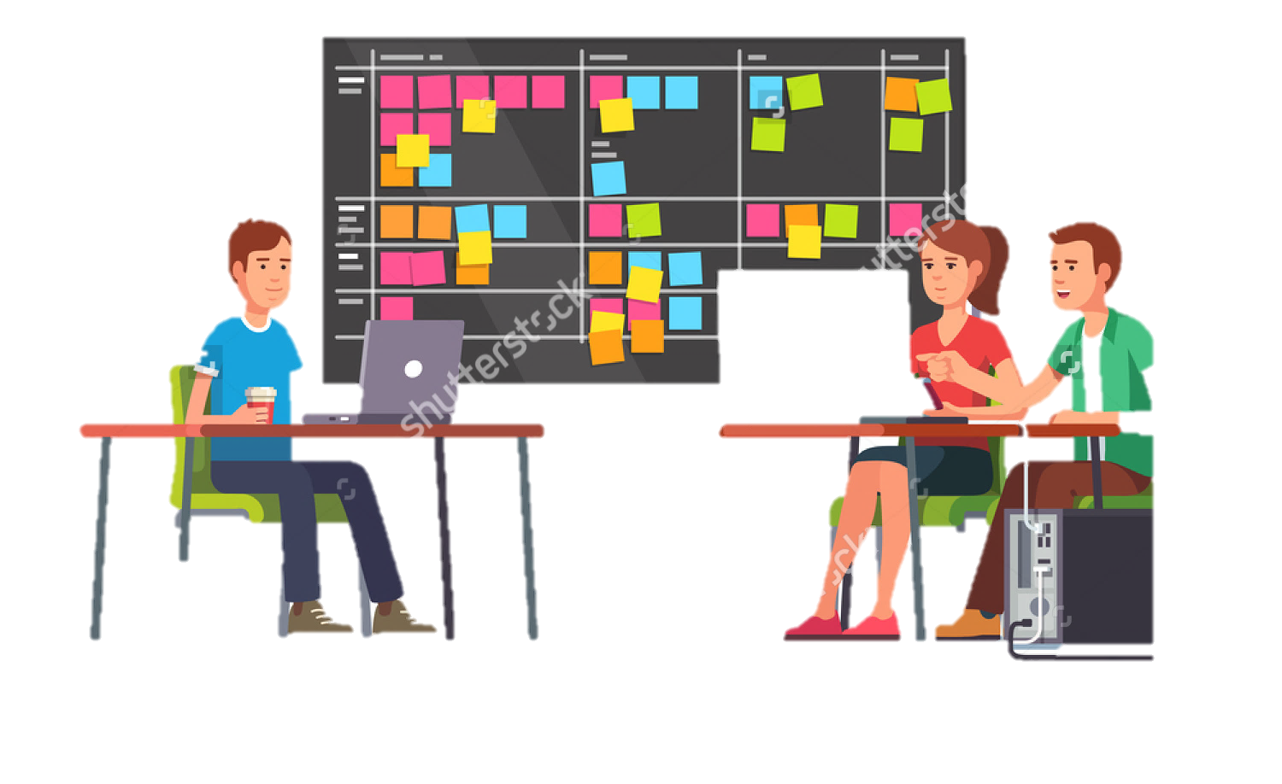
Agenda
Gathering Requirements
Technologies
User Stories
Planning Poker
Estimation of project
Big Board (Initial)
Changes during Iteration
Final Big Board
Milestone 1.0

Slide 3




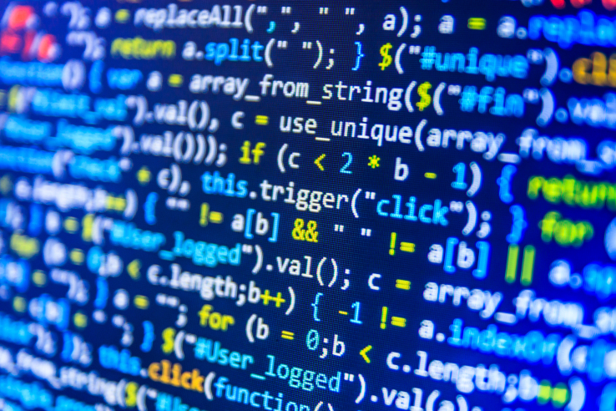
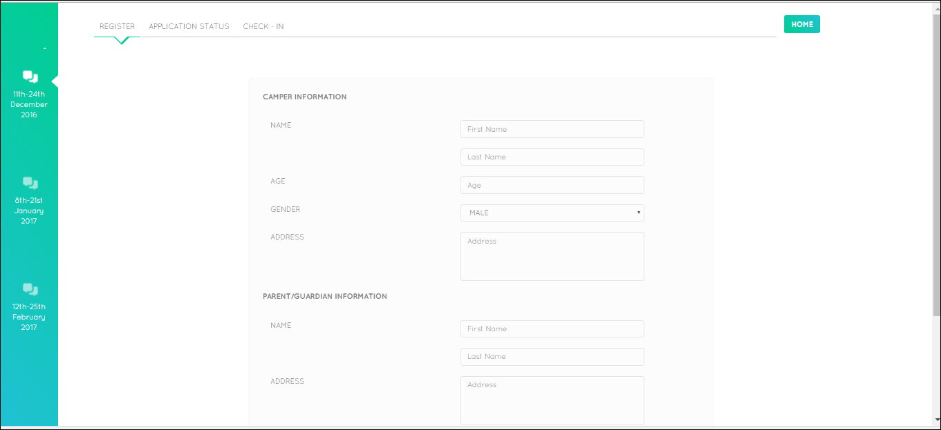
Agenda
Refactoring
SRP
DRY
Version Control
Testing
Code
UI
Challenges & Learnings

Slide 4
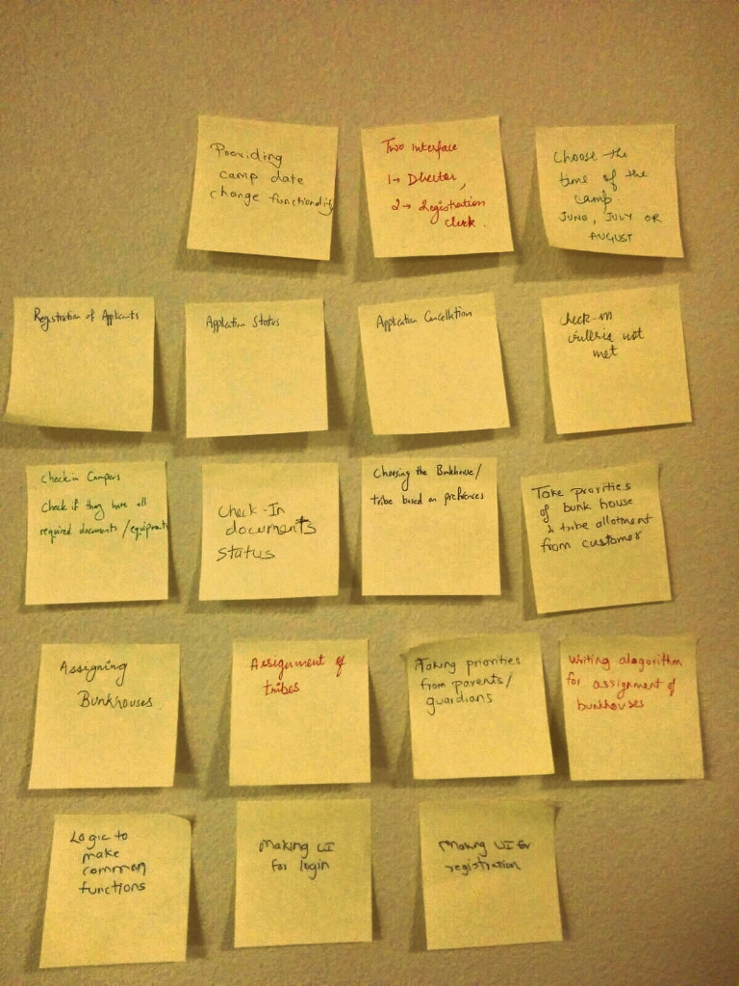
1
Gathering Requirement
Blueskying
Brainstorming
Role Playing
TEST DRIVEN DEVELOPMENT

Slide 5



2
Technologies

Slide 6


3
User Stories
User story 1:
Choosing the date
Description: Choose from the three dates.
User story 2:
Registration
Description: Clerk to enter the details of the applicant
User story 3:
Application status
Description: Accepted, rejected or waitlist.
User story 4:
Application Cancellation
Description: cancellation of application.
User story 5:
Refund
Description: Refund amount based on cancellation date.
User story 6:
Check-in
Description: Check-in of applicant after checking of all documents.

Slide 7
3
User Stories
User story 7:
Assignment to Bunkhouses
Description : based on various factors.
User story 8:
Assignment to Tribes
Description : based on various factors.
User story 9:
Login
Description : registration clerk(for now).
User story 10:
Maintenance
Description : ???.

Slide 8
4
Planning Poker
Prioritizations | User Stories | Rohan | Jemin | Karthik | Sohiel | Average
10 | Choosing Date | 5.00 | 4.00 | 5.00 | 5.00 | 5.00
10 | Registration | 3.00 | 2.00 | 3.00 | 2.00 | 3.00
20 | Application Status | 4.00 | 4.00 | 4.00 | 4.00 | 4.00
20 | Check In | 4.00 | 5.00 | 4.00 | 4.00 | 5.00
30 | Assignment of Bunk Houses | 8.00 | 8.00 | 8.00 | 8.00 | 8.00
30 | Assignment of Tribes | 10.00 | 10.00 | 9.00 | 10.00 | 10.00
40 | Application Cancellation | 3.00 | 3.00 | 3.00 | 3.00 | 3.00
40 | Refund | 8.00 | 7.00 | 8.00 | 7.00 | 8.00
50 | Log In | 2.00 | 3.00 | 2.00 | 3.00 | 3.00
50 | Maintenance | 15.00 | 13.00 | 15.00 | 14.00 | 15.00
 | Total Sum | 62.00 | 59.00 | 61.00 | 60.00 | 64.00
 | Total Sum till MileStone 1 | 34.00 | 33.00 | 33.00 | 33.00 | 35.00
 | Total Sum after MileStone 1 | 28.00 | 26.00 | 28.00 | 27.00 | 29.00
Prioritization given by customer

Slide 9
4
Estimating project schedule
Milestone 1 | Calculation
Start Day | 9/19/2016
End Day | 10/19/2016
Number of days before release (Calendar days) | 31.00
Estimated Days of Work | 64.00
Number of people in Team | 4.00
Number of workdays left (Only Week Days) | 22.00
Holidays by Developers | 0.00
Number of workdays left (Excluding Holidays) | 22.00
Velocity | 0.40
Available Work Days | 8.80
Amount of work team is likely to complete before due date | 35.00
Days of work that could be deferred | 29.00

Slide 10
4
Big Board
User Story 1: Choosing the date
Task No. | Task | Developer | Time
1 | Making the date class (Entity) Making the CSV File | Soheil | 1 hr
2 | Making the logic of choosing the date: Connecting it to the CSV File | Rohan | 4 hrs
3 | Connecting the choosing date logic to the UI | Karthik | 3 hrs
4 | Testing the logic Testing the UI | Jemin | 1 day
5 | Common functions | Rohan | 5 hrs
User Story 2: Registration
Task No. | Task | Developer | Time
1 | Making the Applicant Class (Entity) Making the CSV File | Jemin/Soheil | 2 hrs
2 | Adding Transformations to the Applicant class | Jemin/Soheil | 4 hrs
3 | Making the logic for the Applicant class | Jemin/ | 3 hrs
4 | Making the common functions for the Applicant Class | Rohan | 5 day
5 | Connecting the Registration logic to the UI | Karthik | 3 hrs
6 | Testing the logic, Testing the UI | Jemin | 1.5 days
User Story 3: Application Status
Task No. | Tasks | Developer | Time
1 | Creating the Common functions for reading/writing/updating the application status, Making the logic | Rohan | 5 hrs
2 | Reading from the file and adding constraints for Age, Registration, Date Windows, Check Clearing | Rohan | 2 days
3 | Connecting to the UI | Karthik | 1 day
4 | Testing the logic: Testing the UI | Jemin/ Soheil | 3 days
User Story 4: Check-In
Task No. | Tasks | Developer | Time
1 | Creating the Common functions for reading/writing/updating the Check-In | Rohan | 5 hrs
2 | Making the logic for providing the CSV to the UI | Karthik | 1.5 days
3 | Connecting the read data to the UI | Karthik | 1 day
4 | Making the logic for moving data from UI to CSV | Karthik/ Rohan | 1 day
5 | Testing the UI | Jemin/ Soheil | 3.5 days

Slide 11
4
Big Board
User Story 5: Assignment to Bunkhouse
Task No. | Task | Developer | Time
1 | Making the Bunkhouse class (Entity) Making the CSV File | Jemin | 2 hrs
2 | Making the logic of Assignment to bunkhouses: Connecting it to the CSV File | Rohan | 4 hrs
3 | Connecting the bunkhouse logic to the UI | Karthik | 3 hrs
4 | Testing the logic Testing the UI | Soheil | 3 days
User Story 6: Assignment to Tribe
Task No. | Task | Developer | Time
1 | Making the Tribe Class (Entity) Making the CSV File | Soheil | 1 hrs
2 | Making the logic of Assignment to Tribes: Connecting it to the CSV File | Karthik | 3 hrs
3 | Connecting bunkhouse logic to UI | Karthik | 3 hrs
4 | Testing the logic Testing the UI | Jemin | 3 days

Slide 12
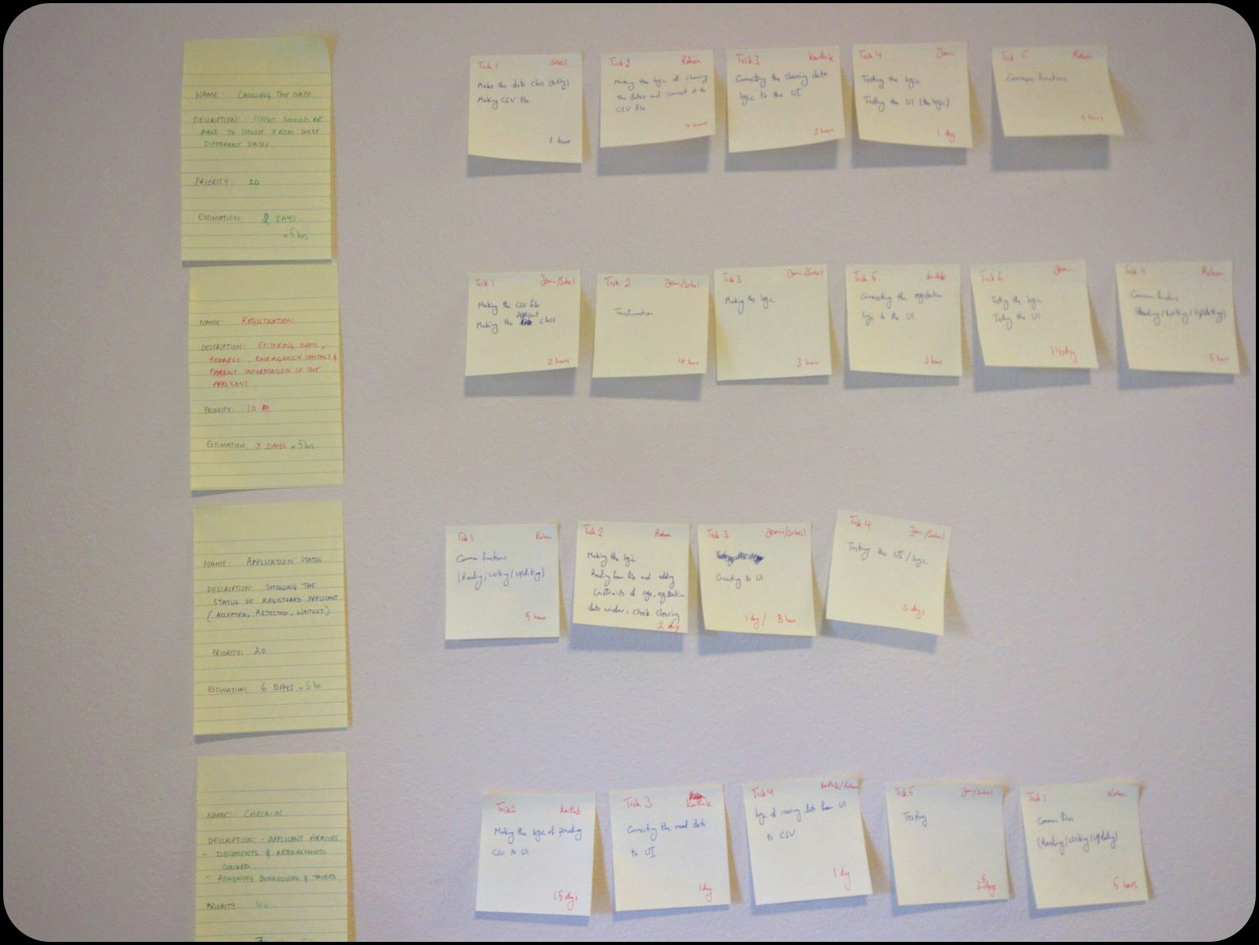
4
Big Board (Our Actual Board)

Slide 13

5
Burn Down Chart (Iteration 3)
We are not on track

Slide 14

5
Burn Down Chart (Milestone 1)
We are on track

Slide 15
6
Milestone 1.0
User story 1:
Choosing the date
Description: Choose from the three dates.
Priority : 10
Time : 2 days 5 hrs
User story 2:
Registration
Description: Register the applicant
Priority : 10
Time3 days 5 hrs
User story 3:
Application status
Description: Accepted, rejected
Priority: 20
Time : 7 days 5 hrs
User story 4:
Check-in
Description: Check for required documents
Priority: 40
Time: 7 days 5 hrs

Slide 16
7
Version Control
Link: https://github.com/karbmk/software_development_cgu
Git commands:
git clone https://github.com/karbmk/software_development_cgu
git pull
git add .
git commit –a –s
git push origin master
Merge conflicts:
git checkout <files creating conflict>

Slide 17
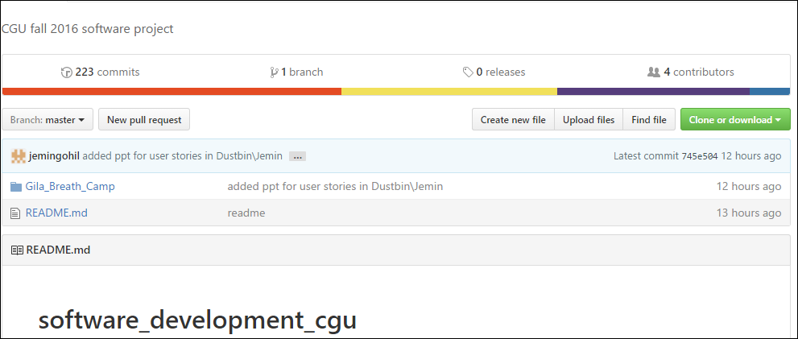
7
Version Control
223 commits ☺
README.md for installation

Slide 18
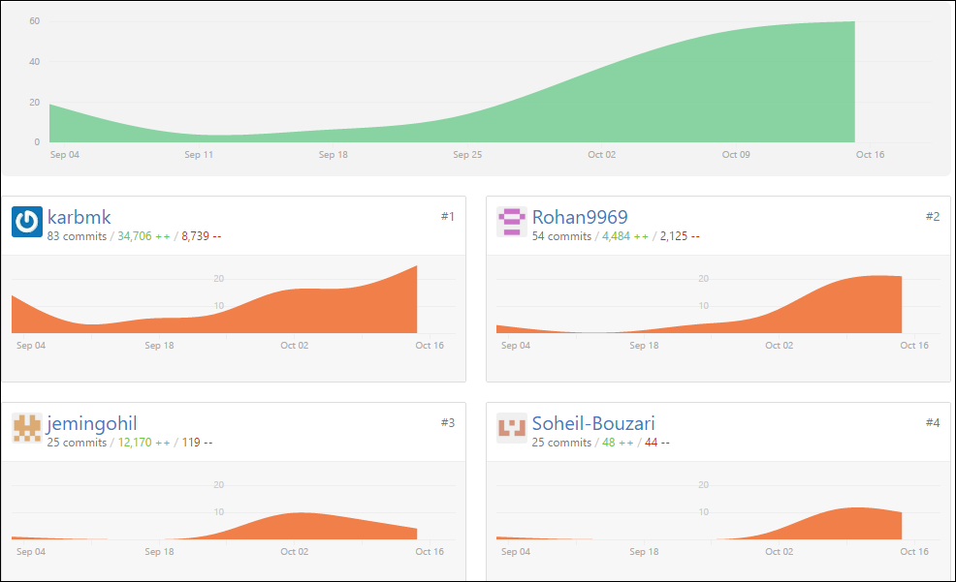
7
Version Control
80% of the work done in 20% of the time.. So much true for whole project and each individual as well
Start date 4th Sept 2016
83 commits by me ☺

Slide 19
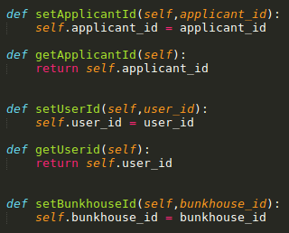
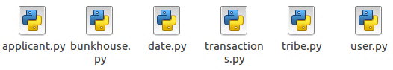
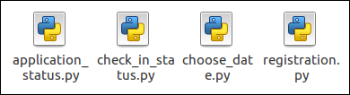
8
Refactoring : SRP
Creating objects with independent methods.
For example:
Class Applicant in applicant.py calls its own function setApplicantId() to set applicant_id. These objects are then used by their respective user stories only

Slide 20
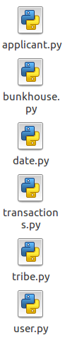


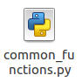
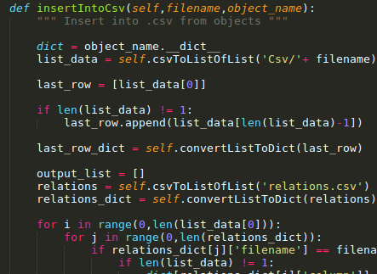
8
Refactoring : DRY
Creating a Common File for read/write/update/increment user id
CSV file

Slide 21
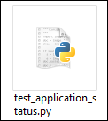
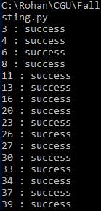
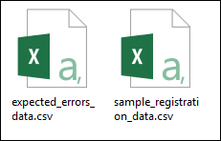
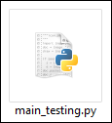
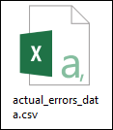
9
Testing (Automated)
unittest
pytest
Performs operations on Sample data and create
Sample Data Files:
Data for user story
Expected result

Slide 22
9
Bugs
Bug No. | Description | Criticality | Status | Resolved by | Comments
1 | Applicant not falling in a particular slot also being displayed | High | Resolved | Rohan | Changed the getCsv code
2 | Client/server connection lost randomly | High | Resolved | Karthik | handled the errors from client server
3 | Data length not retrieved for a particular slot in the UI | Medium | Resolved | Karthik | maintaing different valible for length
4 | Applicant age limit not recognizing (False true) | High | Resolved | Rohan | divided ages according to slots properly
5 | Gender limit of 36 was buggy | Low | Resolved | Rohan | male and female for separate slots are made independent
6 | Payment of $1000 and above being accepted | Low | Resolved | Jemin | made to accept only $1000
7 | First and last name not taking space separated names | Low | Resolved | Soheil | modified transformations to accepted space separated names
8 | Home button not there for clerk exit | Low | Resolved | Karthik | added home button in UI
9 | Applicant details for application status was being populated same as checkin which should not be the case | High | Resolved | Karthik | dividing applicant and checkin list modular
10 | Not converting date in proper format(MM-DD-YYYY) | Medium | Resolved | Jemin | modified the code to python readable format
11 | Multiline words in addresses are'nt being handled | Low | Resolved | Rohan | made to accept multiline addresses
12 | User is is being hardcoded since clerk is the only user | Medium | Open

Slide 23
10
Code and UI
Lets got to UI and check it out

Slide 24
11
Challenges
1. Everyone:
a. Estimation of time for user stories
b. Making data for our testing
c. Balancing of workload
2. Rohan/Karthik: Understanding the testing module – unittest
3. Soheil: Balance the workload with other courses – Understanding
Some actual project coding standards
4. Jemin: Understanding the software development practices in actual running application

Slide 25


Slide 26
REFERENCES
http://www.thehealthcarepeople.com/2015/02/16/top-three-challenges-healthcare-professionals-physicians/
https://docs.python.org/2/library/unittest.html
https://www.djangoproject.com/
https://docs.python.org/2/howto/webservers.html
http://stackoverflow.com/questions/5788521/reading-a-csv-file-using-python
https://guides.github.com/activities/hello-world/
http://lifehacker.com/5983680/how-the-heck-do-i-use-github
https://www.python.org/about/success/

